Slide 1
01
WNBA Ticket Sales Analytics
INTRO Business Problem Analytics Problem Presentation of Results Insight Gained Strategies For Growth

Slide 2
Table of Contents
02
1
Overview of Business Problem
2
Analytics Problem
3
Presentation of Results
4
Business Insight Gained
5
Strategies For Growth
INTRO Business Problem Analytics Problem Presentation of Results Insight Gained Strategies For Growth

Slide 3
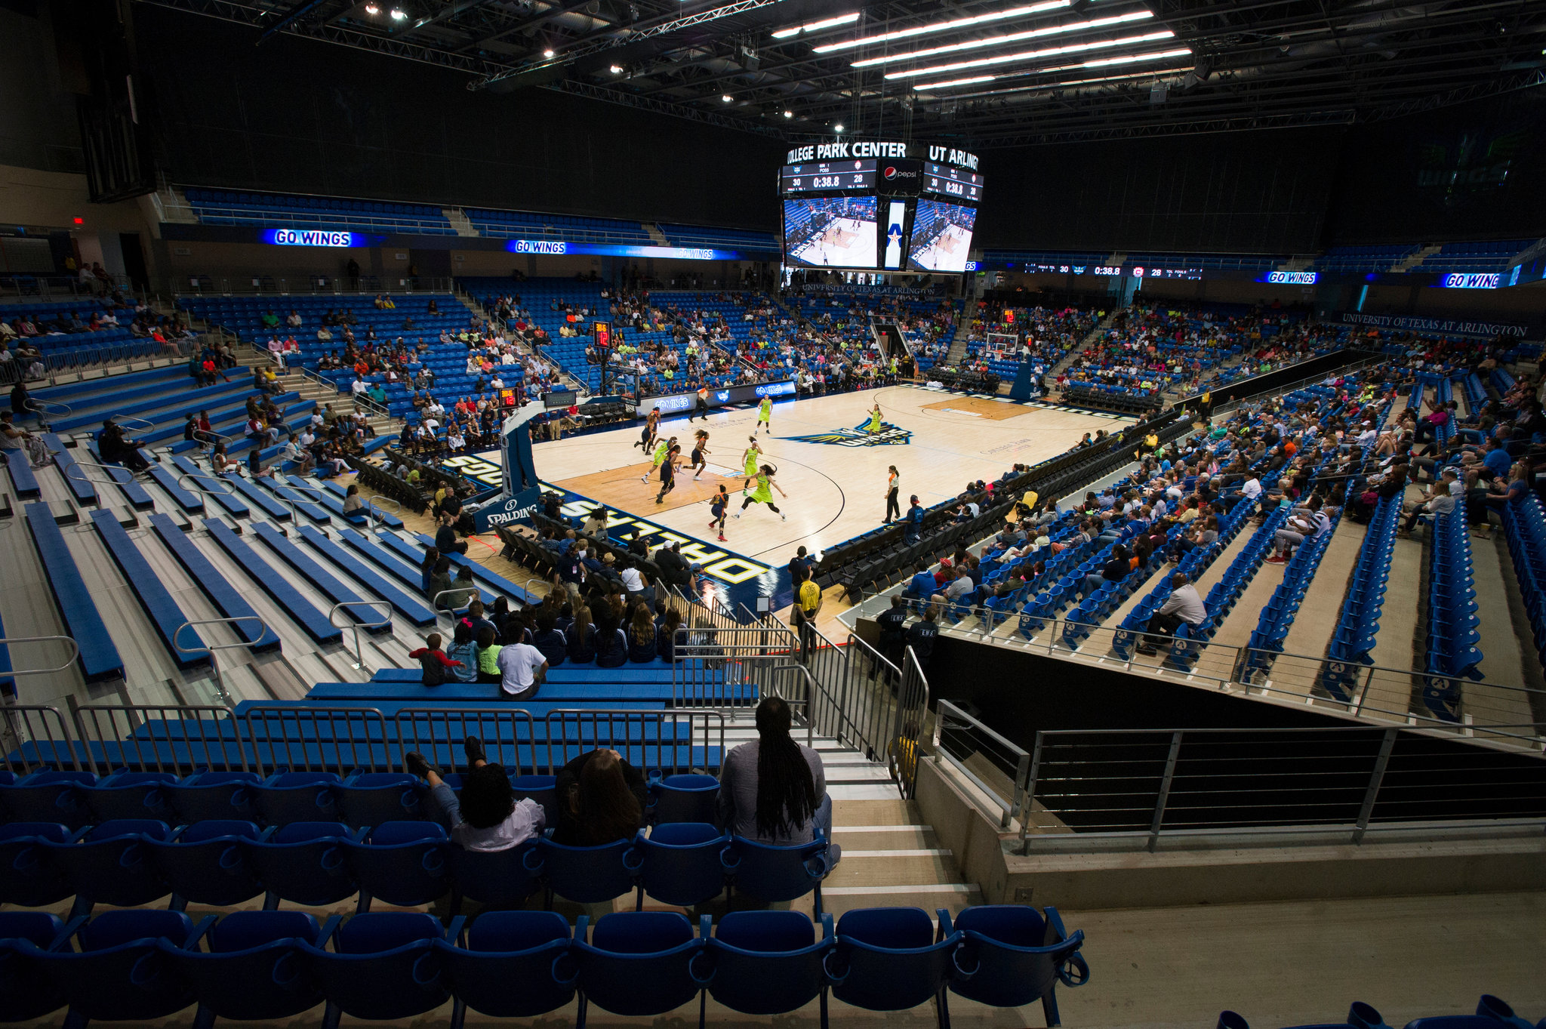
Business Problem
03
Addressing low ticket sales is crucial for improving the WNBA's revenue and reducing net losses.
Challenges with Ticket Sales
WNBA struggles to generate consistent revenue
Frequent net losses reported
Low ticket sales as a key factor
Exploring underlying causes and potential solutions
INTRO Business Problem Analytics Problem Presentation of Results Insight Gained Strategies For Growth

Slide 4

Analytics Problem
04
Data analysis revealed attendance trends using diverse visualization tools to uncover patterns and insights.
Analyzed a Range of Statistical Data
Average attendance
Peak attendance
Postseason attendance
Utilized Diverse Visualization Tools
Line charts
Pie charts
Heat maps
Box and Whisker charts
Scatter plots
INTRO Business Problem Analytics Problem Presentation of Results Insight Gained Strategies For Growth

Slide 5
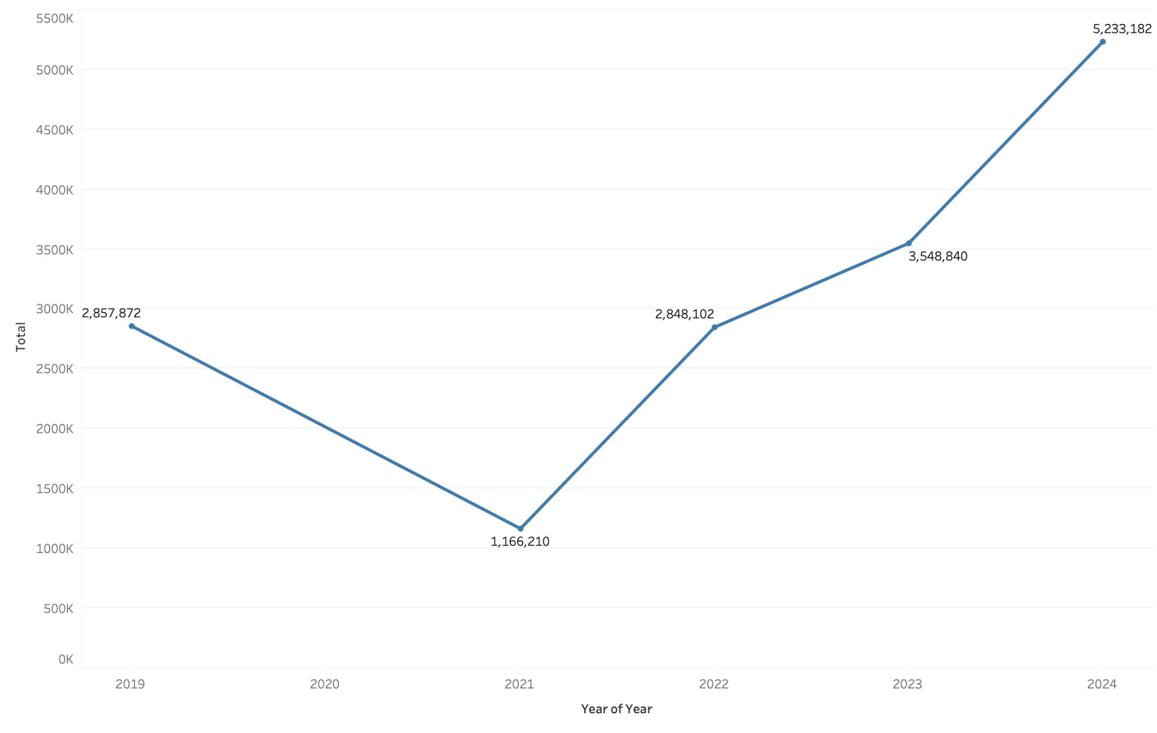
Presentation of Results (1/5)
05
Growth Of WNBA Over the Years
INTRO Business Problem Analytics Problem Presentation of Results Insight Gained Strategies For Growth

Slide 6
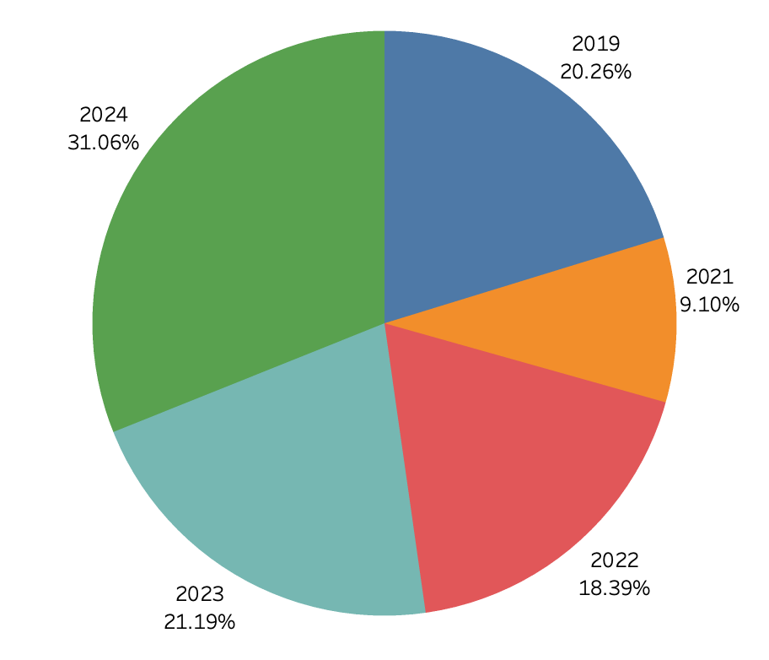
Presentation of Results (2/5)
06
Viewership Per Year
INTRO Business Problem Analytics Problem Presentation of Results Insight Gained Strategies For Growth

Slide 7
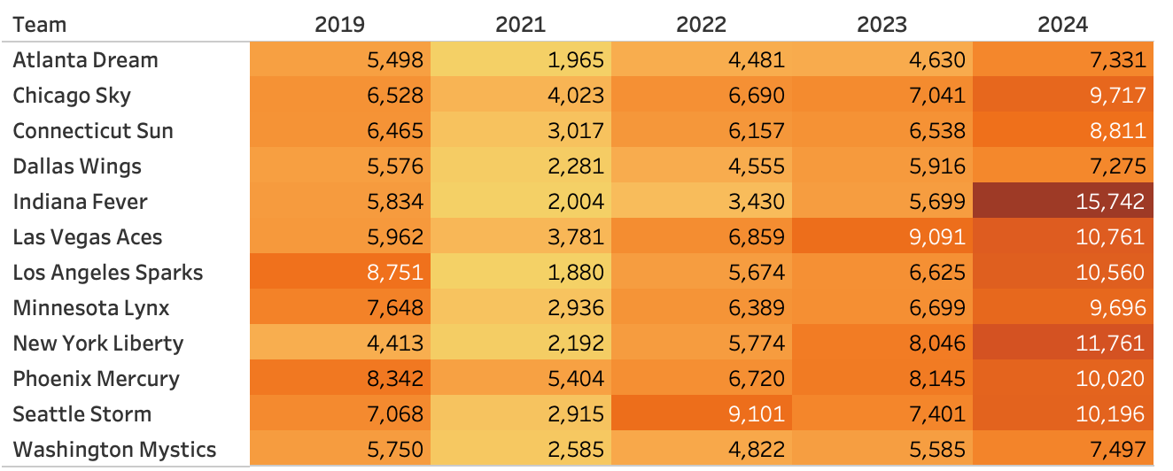
Presentation of Results (3/5)
07
Average Attendance Per Year
INTRO Business Problem Analytics Problem Presentation of Results Insight Gained Strategies For Growth

Slide 8
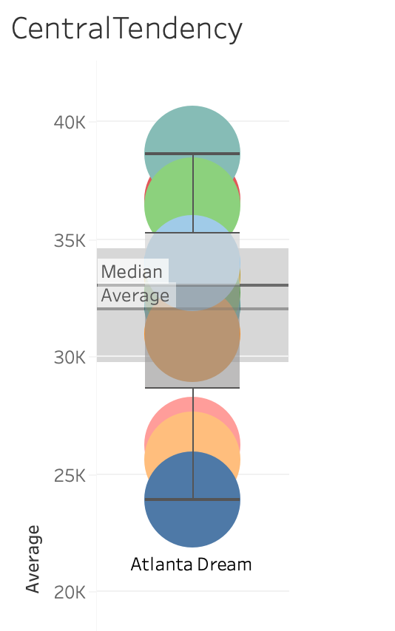
Presentation of Results (4/5)
08
Box and Whisker Plot for Average Ticket Sales by Team
INTRO Business Problem Analytics Problem Presentation of Results Insight Gained Strategies For Growth

Slide 9
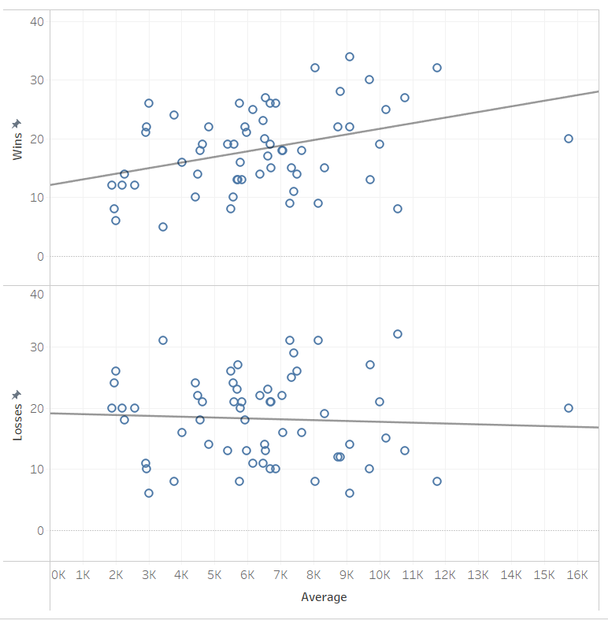
Presentation of Results (5/5)
09
Average Ticket Sales Based on Wins and Losses
INTRO Business Problem Analytics Problem Presentation of Results Insight Gained Strategies For Growth

Slide 10

Insight Gained
10
The league rebounded strongly post-COVID, with star power and team success driving record-breaking attendance in 2024.
Demonstrates COVID's Impact on the League
2020 season canceled
Multi-season recovery to pre-pandemic levels
Signs of Recovery and Growth
Record-breaking 2024 season
League trending in the right direction
Highlights Key Attendance Drivers
Star power's influence on fan engagement
Correlation between team success and attendance
INTRO Business Problem Analytics Problem Presentation of Results Insight Gained Strategies For Growth

Slide 11
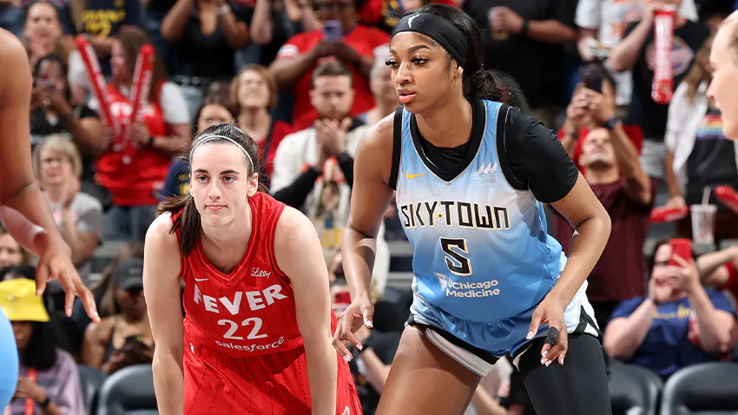
Strategies For Growth
11
Focused strategies in marketing, scheduling, and community engagement can ensure sustained growth for the WNBA.
Enhancing Fan Experience:
Game promotions, family-friendly events, and giveaways
Aligning game schedules with peak availability (weekends/evenings)
Leveraging Support and Data:
NBA collaboration: $15M endowment and player advocacy
Data-driven marketing: demographic insights and targeted outreach
Expanding media visibility: streaming platforms and major broadcasters
INTRO Business Problem Analytics Problem Presentation of Results Insight Gained Strategies For Growth

Slide 12

12
INTRO Business Problem Analytics Problem Presentation of Results Insight Gained Strategies For Growth

